Slide 1



Introduction to
Longitudinal Control

Slide 2

Learning Objective
Introduction to Longitudinal Control System
Basics of Linear Time-Invariant (LTI) Control
Proportional Integral Derivative (PID) Controllers
Step Response of PID and Other Controllers
Longitudinal Control with PID

Slide 3
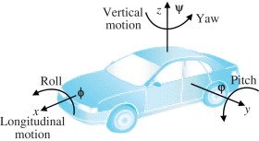
Definition
The term “Longitudinal Controller” is typically used in referring to any control system that controls the longitudinal motion of the vehicle.
Example
  The longitudinal velocity, acceleration or the longitudinal distance of a vehicle from another preceding vehicle in the same lane on the highway. The throttle and brakes are the actuators used to implement longitudinal control.

Slide 4
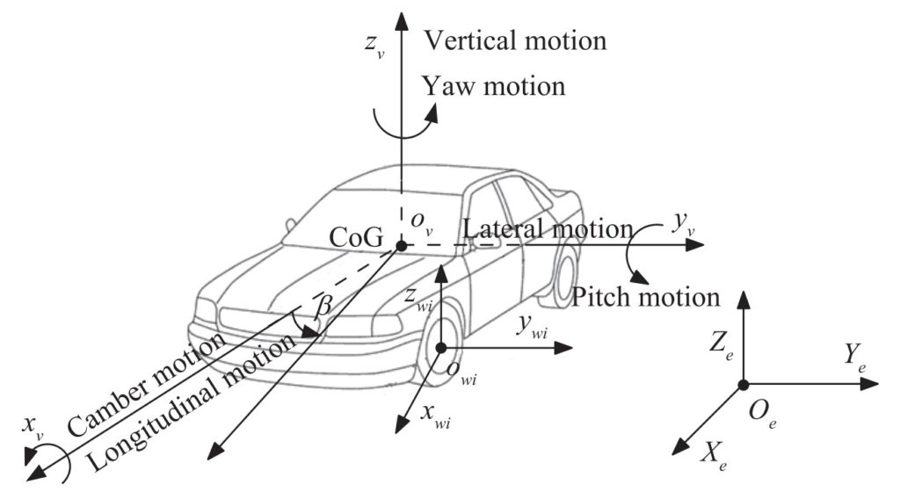
Example

Slide 5
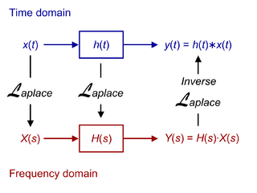
Basics of LTI Control
A system that possess two basic properties namely linearity and time-invariant is known as Linear Time Invariant (LTI) System.
Background Knowledge

Slide 6
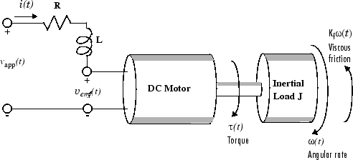
Basics of LTI Control
Reasons to use LTI Systems
Two major reasons
  The mathematical model analysis becomes easier.
  Many physical processes through not absolutely LTI systems can be approximated with the properties of linearity and time invariance.

Slide 7
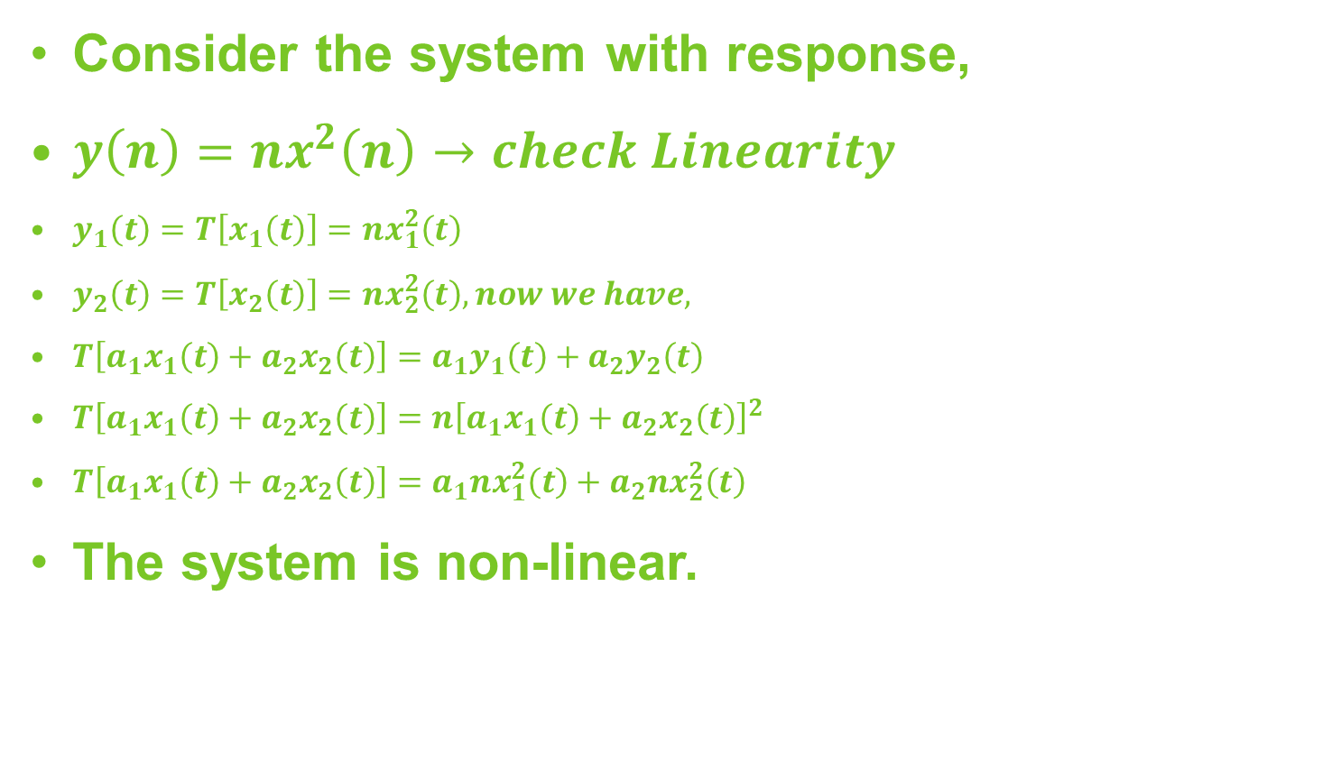
Basics of LTI Control
How to check the linearity and time variance of the system that system is either.
Linear and time invariant (LTI)
Linear and time variant (LTV)

Slide 8
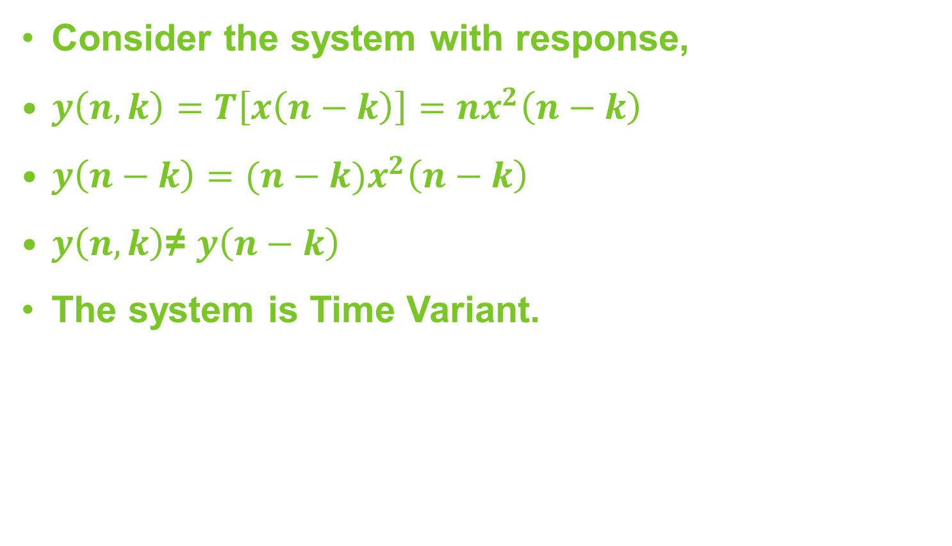
Basics of LTI Control
Check the system is Time Variant or Time Invariant.

Slide 9
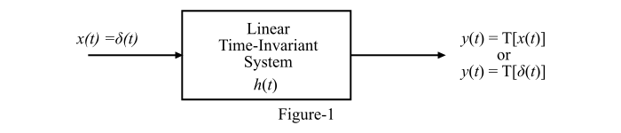
Basics of LTI Control
The LTI Systems are always considered with respect to the impulse response. That means the input is the impulse signal and the output is the impulse response.
Continuous-Time LTI System

Slide 10
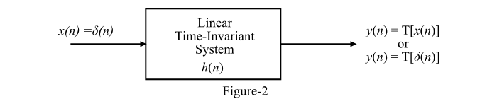
Basics of LTI Control
Discrete-Time LTI System
In this system the time is defined at every point so called discrete system.
Shown in fig.

Slide 11
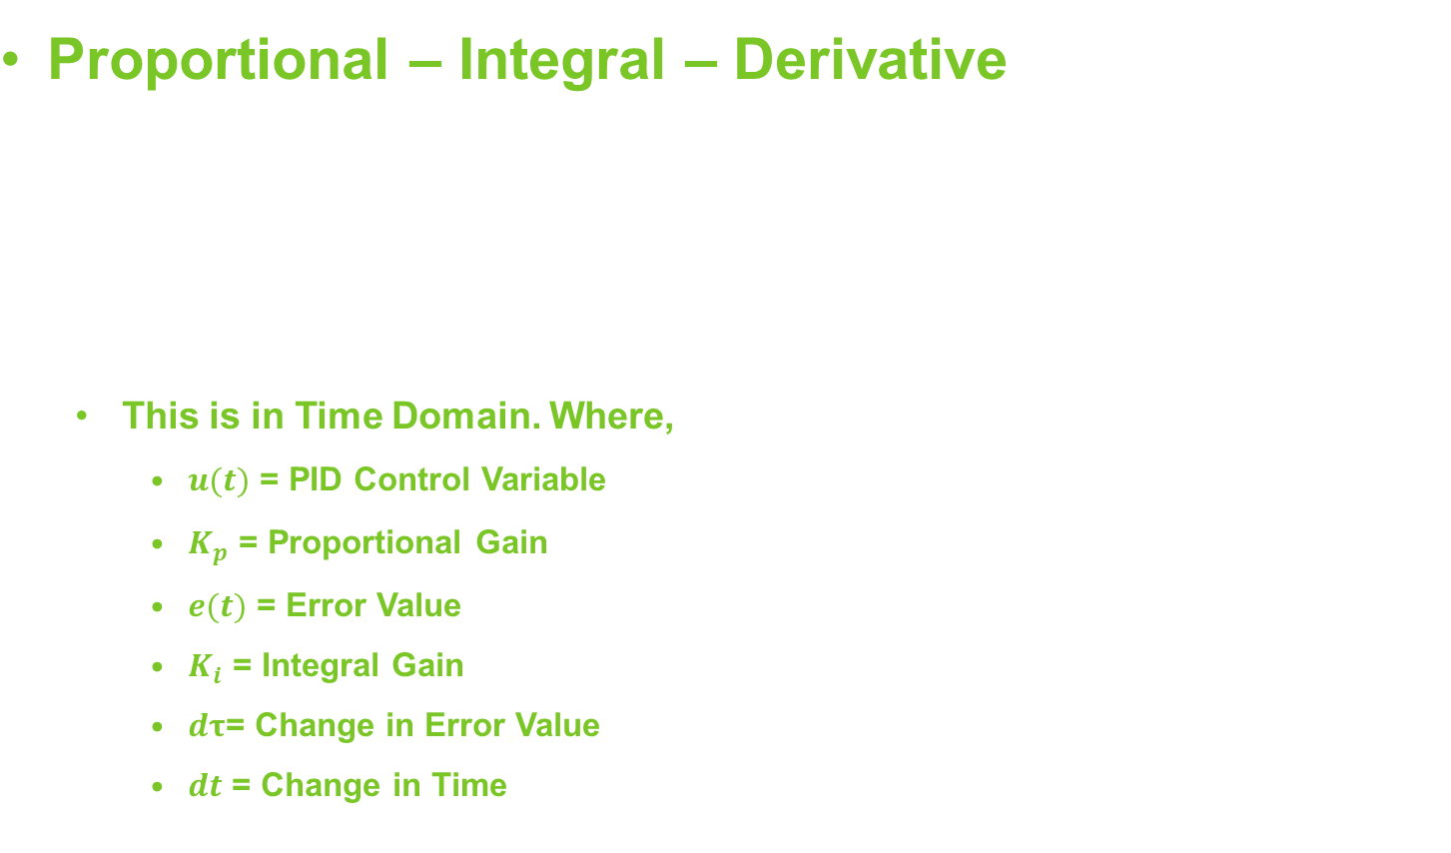
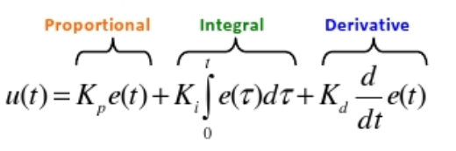
PID Controller
PID control is mathematically formulated by adding three dependent on the error function.

Slide 12
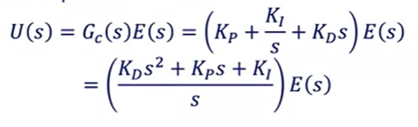
PID Controller
Proportional – Integral – Derivative
This is in Laplace Domain.
If one or more PID gains are set to zero, the controller can be referred to as P, Pd, or Pi.
The pole is at origin.
The zeros can be arbitrary places on the complex plane.
PID controller design selects zero locations by selecting P, I and D gains.
NOTE: Not all gains need to be used for all systems.

Slide 13
PID Controller
Characteristics of P, I, & D Gains
Closed Loop Response | Rise Time | Overshoot | Settling Time | Steady State Error
Increase Kp | Decrease | Increase | Small Change | Decrease
Increase Ki | Decrease | Increase | Increase | Eliminate
Increase Kd | Small Change | Decrease | Decrease | Small Change

Slide 14
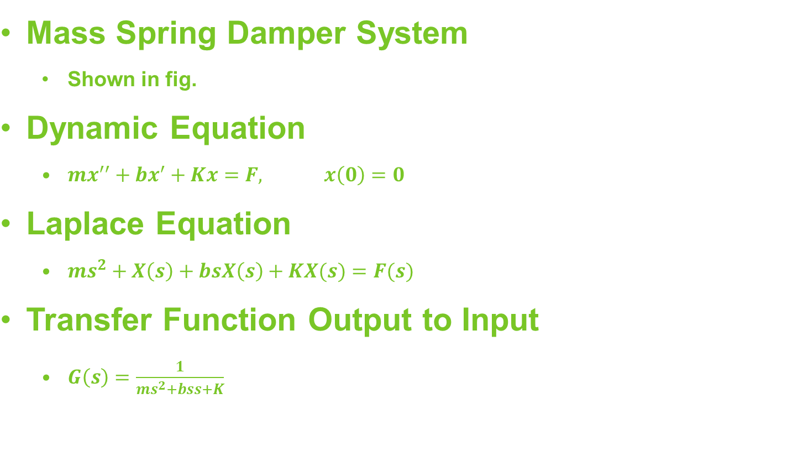
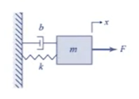
Example
2nd Order System
Dynamic Equation and Laplace equation is given as:

Slide 15
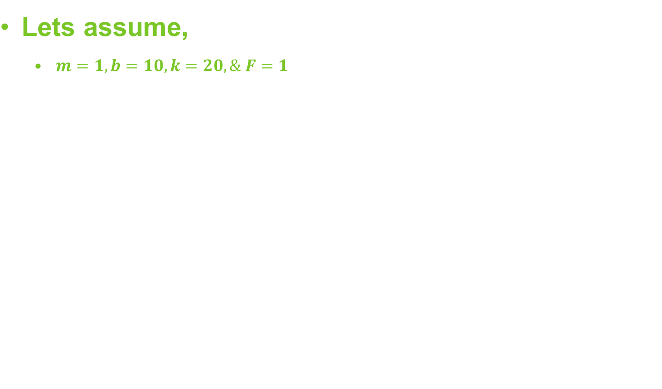
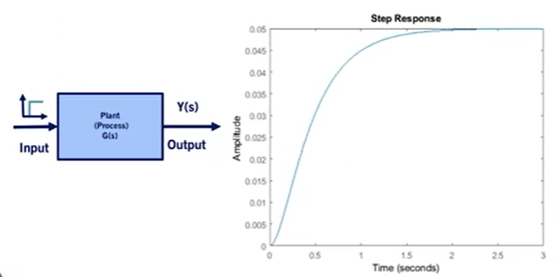
Open Loop Step Response
To evaluate the system characteristics, we excite the system by using a unit step input.

Slide 16
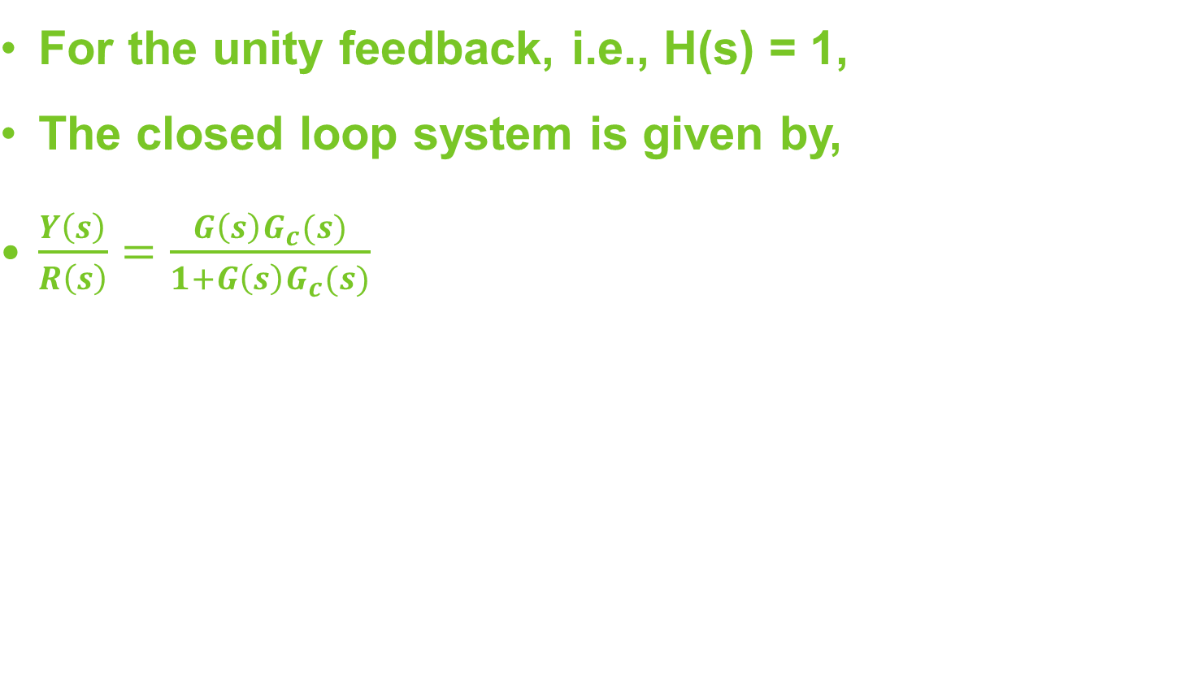
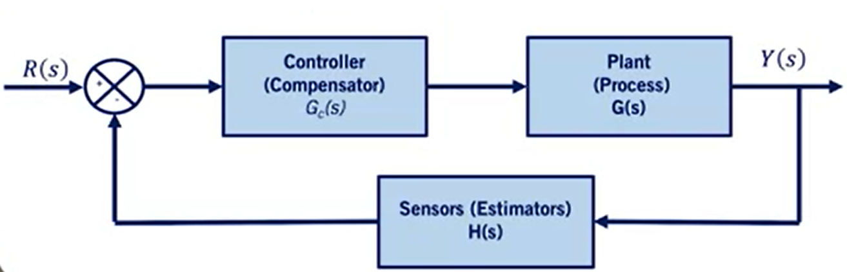
Closed Loop Response
If a controller is added to the plant and the output of the model is measured and compared with the desired output or reference signal, then the response of the system is called Closed-Loop Response.

Slide 17
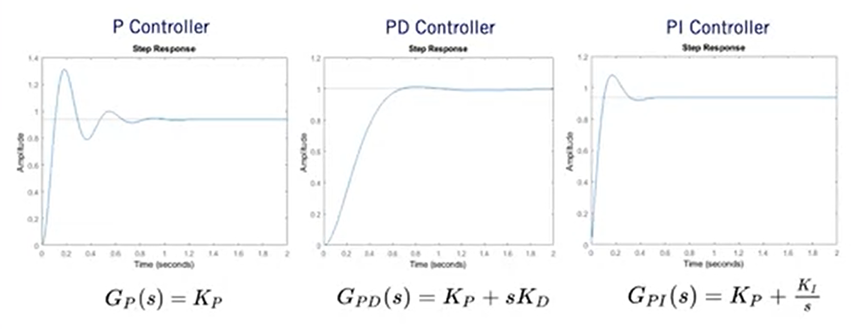
Step Response

Slide 18
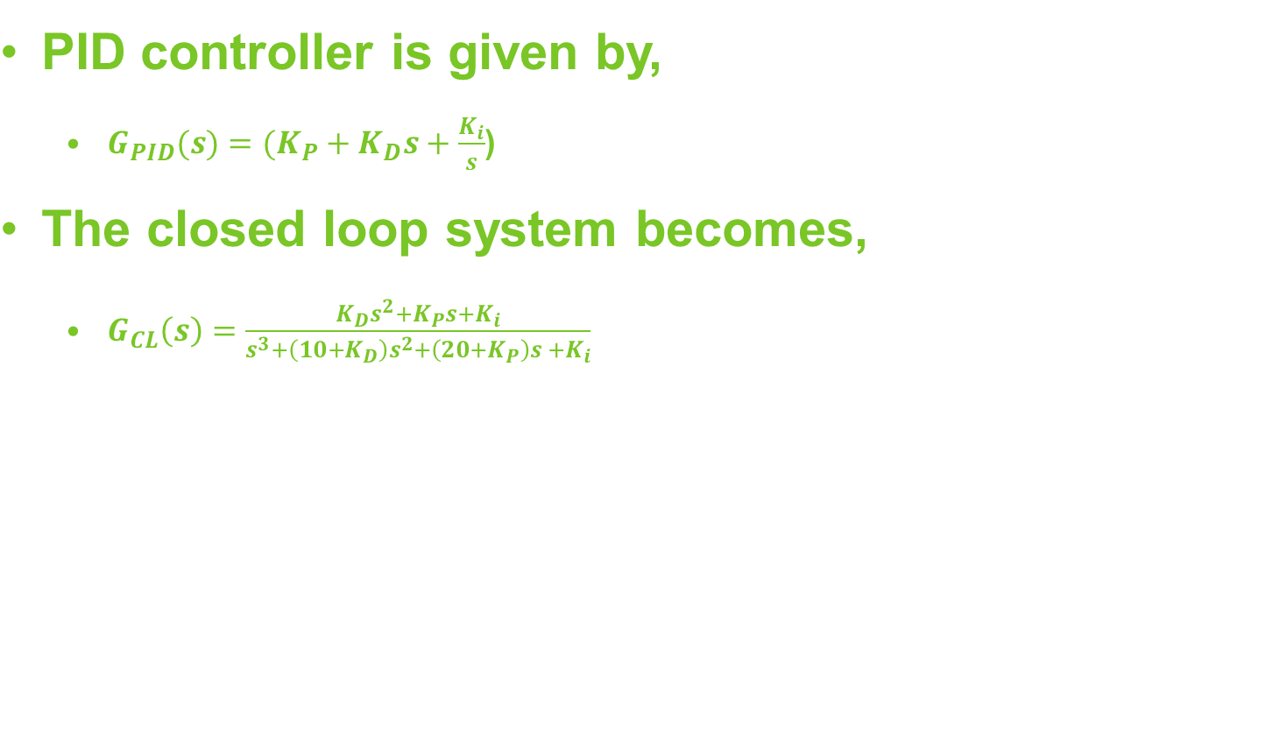
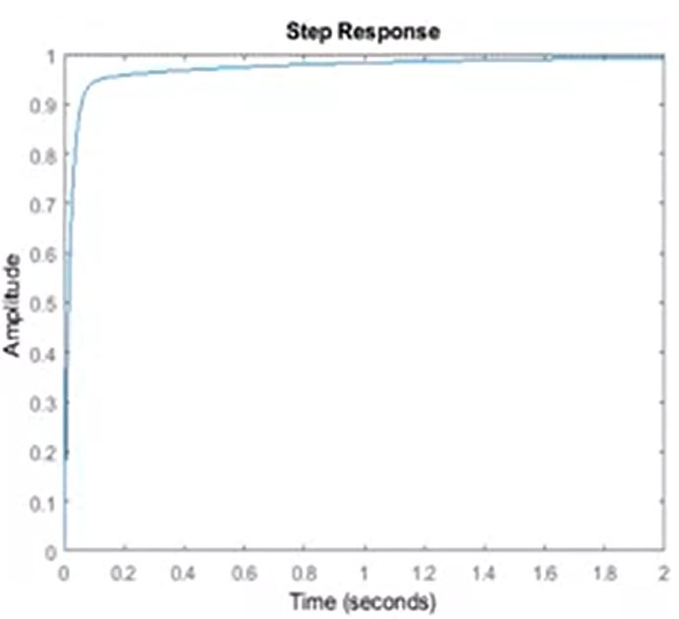
Step Response for PID Controller
Including all three PID terms in the controller, we will get PID controller.

Slide 19
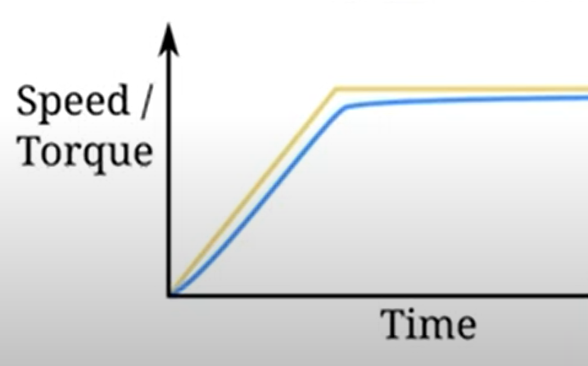
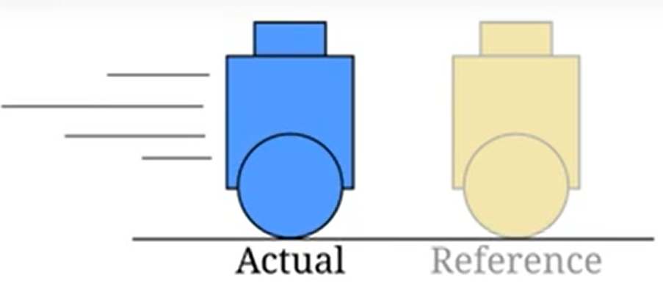
Longitudinal Control with PID
Control: Minimize the offset to reference speed or torque

Slide 20
Summary
We have learned about
Definition of Longitudinal Control
Basics of LTI System
PID Controller
Step Response of PID and Other Controllers
Longitudinal with PID

Slide 21
Thank You

